Slide 1
Maximum Likelihood Estimate
Jyh-Shing Roger Jang (張智星)
CSIE Dept, National Taiwan University

Slide 2
Intro. to Maximum Likelihood Estimate
MLE
  Maximum likelihood estimate
Goal:
  Given a dataset with no labels, how can we find the best statistical model with the optimum parameters to describe the data?
Applications
  Prediction
  Analysis

Slide 3


What Are Statiscal Models?
Statistical models are used to describe the probabilities of random variables
  Discrete variables ➔ Probability functions
  Continuous variables ➔ Probability density functions (PDF)
Examples
  Discrete variables
    The outcome of tossing a coin or a die
  Continuous variables
    The distance to the bull eye when throwing a dart
    The time needed to run 100-m dash
    The heights of second-grade students
Personalized PDF!

Slide 4

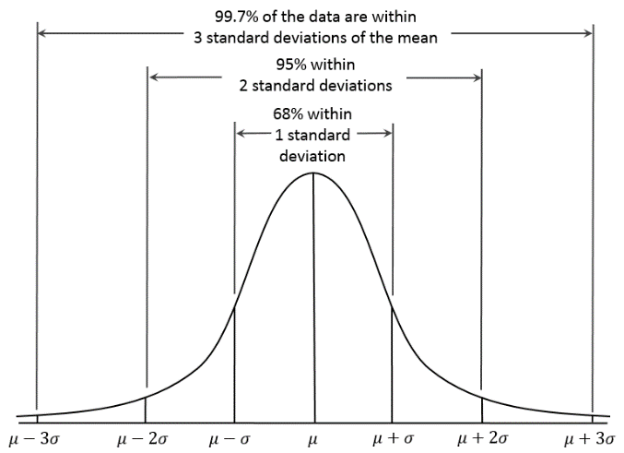
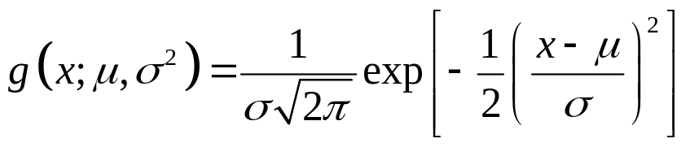
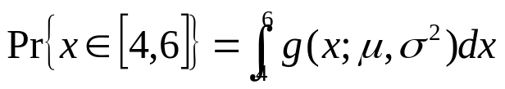
More about Models
Discrete variables
  Outcome of tossing a coin ➔ Pr{head}=1/2, Pr{tail}=1/2
Continuous variables
  Distance to the bull’s eye when throwing a dart ➔ A PDF of Gaussian or normal distribution
Quiz!
Probability of x in [4, 6]

Slide 5
Basic Steps in MLE
Steps
  Perform a certain experiment to collect the data.
  Choose a parametric model of the data, with certain modifiable parameters.
  Formulate the likelihood as an objective function to be maximized.
  Maximize the objective function and derive the parameters of the model.
Examples
  Flip a coin ➔ To find the probabilities of head and tail
  Throw a dart ➔ To find your PDF of distance to the bull eye

Slide 6
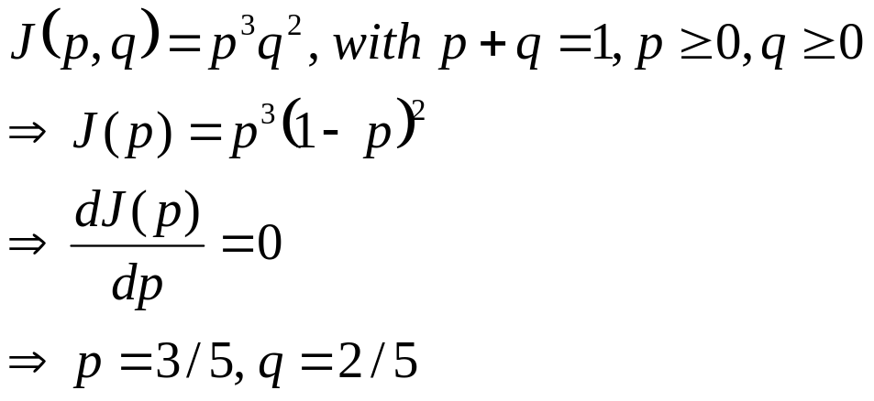
Probability Functions for Discrete Variables
Flip an unfair coin 5 times to get 3 heads and 2 tails
  By intuition: Pr{head}=3/5, Pr{tail}=2/5
  By MLE
    Assume these 5 tosses are independent events to have the overall probability

Slide 7
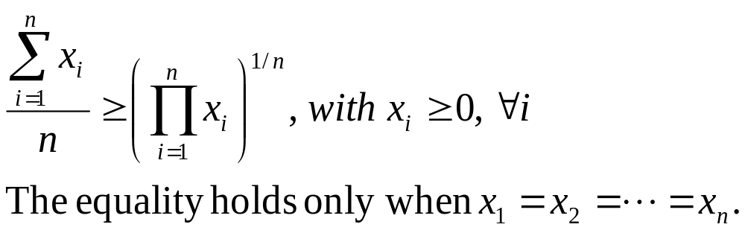
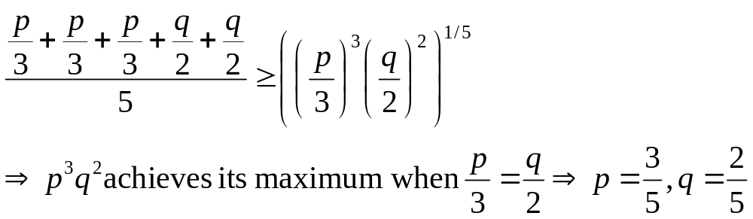
Inequality of Arithmetic and Geometric Means
AM-GM inequality
Proof of this inequality
  Wikipedia
How to use the inequality to solve MLE problem?
Quiz!

Slide 8
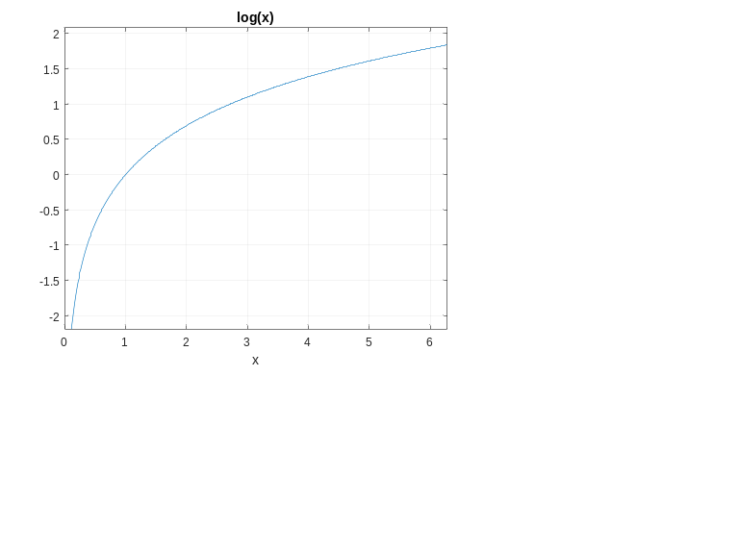
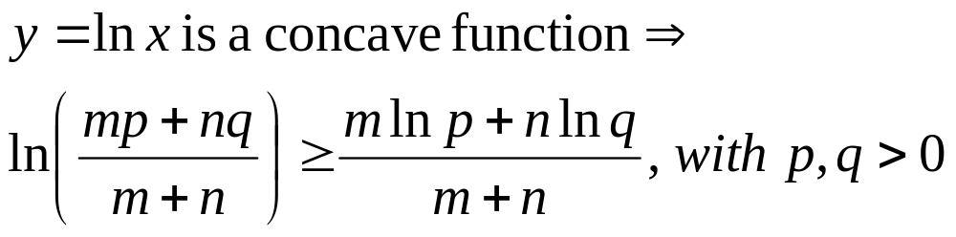
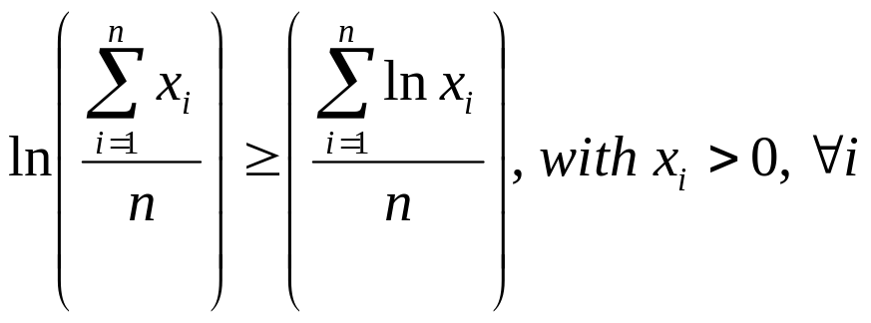
How to Prove AM-GM Inequality?
Jensen’s inequality
Basic inequality
Proof by induction

Slide 9
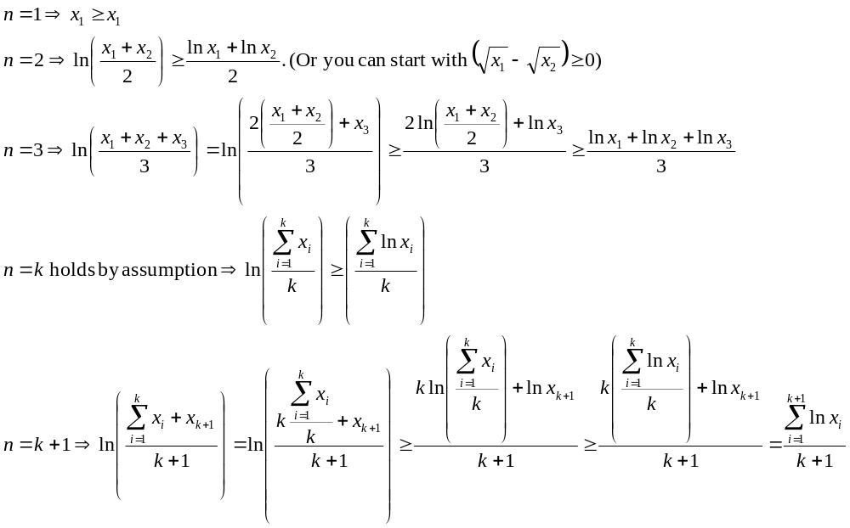
Proof by Induction

Slide 10
Probability Functions for Discrete Variables
Toss a 3-side die for many times and obtain n1 of side 1, n2 of side 2, and n3 of side 3, then what is the most likely probabilities for sides 1, 2, and 3, respectively?
  Our intuition…
  By MLE…

Slide 11
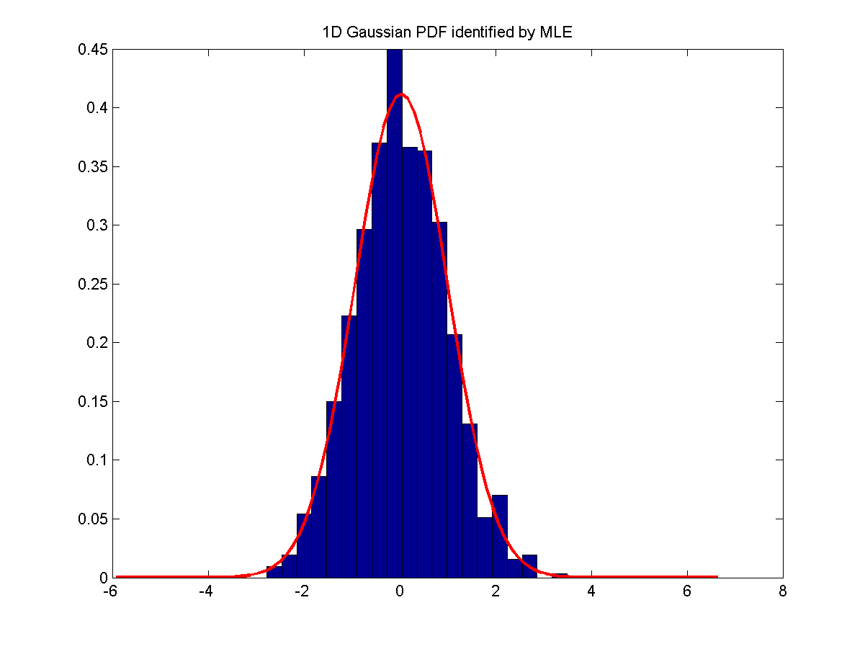
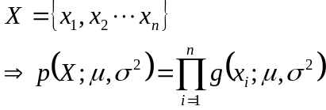
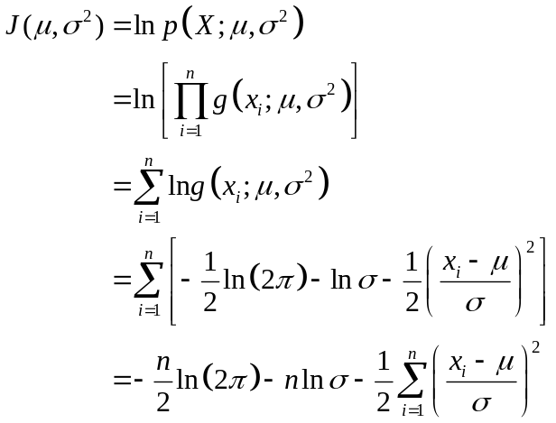
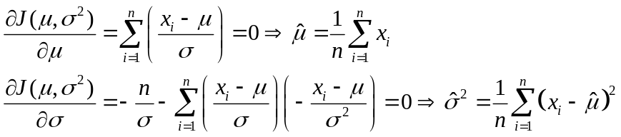
MLE for PDF of Continuous Variables of 1D
Detailed coverage
PDF
Overall PDF,
or likelihood
Log likelihood
MLE
Quiz!

Slide 12
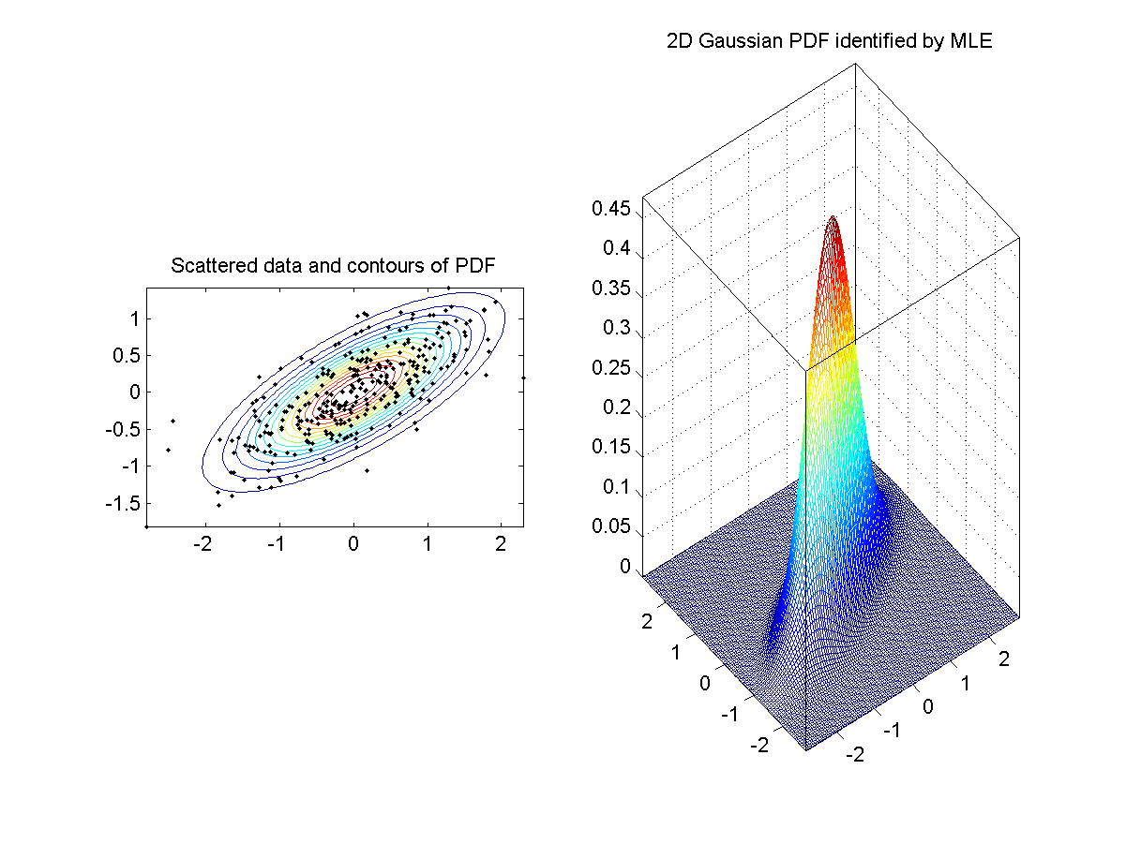
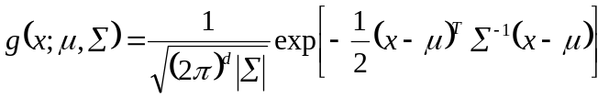
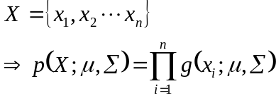
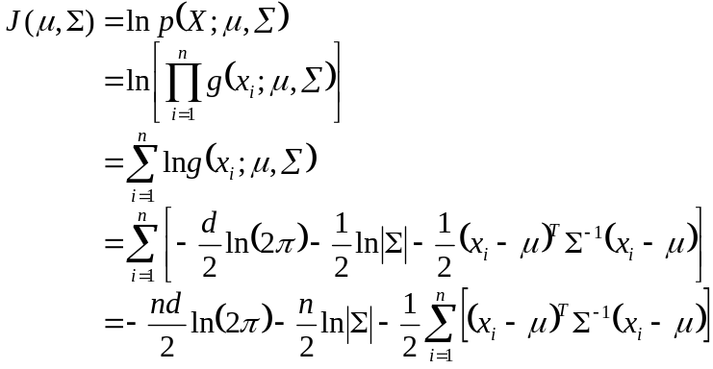
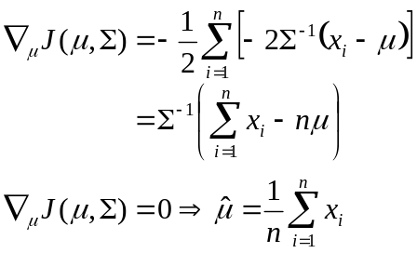

MLE for PDF of Continuous Variables of ND
Detailed coverage
PDF
Overall PDF,
or likelihood
Log likelihood
MLE

Slide 13
Q & A
Questions
  Can we choose other probability density function instead of Gaussian/normal distributions? ➔ Yes!
  What are the other available PDF?

